Slide 1
1.0 INTRODUCTION TO INSTRUMENTAL METHODS
Measurement of analyte’s physical property can be used for quantitative and qualitative analysis.
Types of instrumental methods and their signals
Signal | Instrumental Method
Emission of radiation | Emission spectroscopy (X-ray, UV, Visible, electron); fluorescence, phosphorescence, and luminescence (X-ray, UV, Visible)
Absorption of radiation | Spectrophotometry and photometry (X-ray, UV, Visible, IR); photoacoustic spectroscopy; nuclear magnetic resonance and electron spin resonance spectroscopy
Scattering of radiation | Turbidimetry; nephelometry; Raman spectroscopy

Slide 2
Instrument for Analysis
Component of a typical instrument
Signal Generator
Input Transducer
Signal Processor
Output Transducer
Instrument | Signal Generator | Analytical Signal | Input Transducer | Transduced Signal | Signal Processor | Readout
pH meter | Sample | H⁺ activity | Glass-Calomel electrode | Electrical Potential | Amplifier, Digitizer | Digital unit
Photometer | Tungsten lamp, sample | Attenuated light beam | Photocell | Electrical Current | Amplifier, Digitizer | LED readout

Slide 3
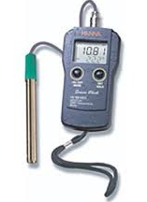
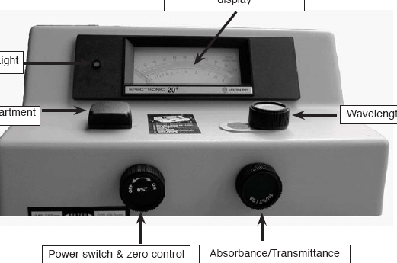

Slide 4
Selection of analytical instrument
Define the problem
Compare to instrument’s figures of merit
Qualitative performance criteria
Defining the problem
1. What accuracy and precision are required?
2. How much sample is available?
3. What is the concentration range of the analyte?
4. What components of the sample might cause interference?
5. What are the physical and chemical properties of the sample matrix?
6. How many samples are to be analyzed?

Slide 5
Performance Characteristics of Instruments; Figures of merit
CRITERION | FIGURE OF MERIT
Precision | Absolute standard deviation, relative standard deviation, coefficient of variation, variance
Bias | Absolute systematic error, relative systematic error
Sensitivity | Calibration sensitivity, Analytical sensitivity
Detection limit | Blank plus three times standard deviation of blank
Concentration range | Concentration limit of quantitation (LOQ) to concentration limit of linearity (LOL)
Selectivity | Coefficient of selectivity

Slide 6
Sensitivity: ability of an instrument to discriminate
between small differences in analyte’s conc.
2 factors affect sensitivity: slope of the calibration
curve and the precision of the instrument.
IUPAC defined sensitivity: slope of the calibration
curve at the concentration of interest.
Most calibration curves used in analytical chemistry
are linear. Therefore,

Slide 7

Sensitivity
Mandel and Stiehler (1964) proposed this equation
to include precision as part of sensitivity. (Analytical
sensitivity).
is analytical concentration
is standard deviation of the measurement
m is calibration sensitivity

Slide 8

Detection limit: defined as the minimum conc. or
mass of analyte that can be detected at a known
confidence level.
The minimum detectable signal is:
Therefore, the limit of detection is given as:

Slide 9
Example 3.1.1
A least-squares analysis of calibration data for the
determination of lead based on its flame emission
spectrum yielded the equation
where c_{pb} is the lead concentration in parts per million and
S is a measure of the relative intensity of the lead emission
line. The following replicate data were then obtained.
Calculate: a. Calibration sensitivity b. Analytical sensitivity at 1 and 10 ppm c. detection limit
ppm Pb | # of replication | Mean value of S | s
10.0 | 10 | 11.62 | 0.15
1.00 | 10 | 1.12 | 0.025
0.000 | 24 | 0.0296 | 0.0082

Slide 10
Concentration range:
LOQ = limit of quantitation = 10s_{bl}
LOL = limit of linearity

Slide 11
Selectivity: defined as the degree to which a
method is free from interference by other species
contained in the sample matrix.
Unfortunately, no method is free of interference
but steps can be taken to minimize their effect.
Consider a sample consisting of analyte A,
interfering species B and C.
Let c_{A}, c_{B}, and c_{C} be the concentration of the
different species respectively and m_{A}, m_{B}, and m_{C}
be calibration sensitivities respectively.

Slide 12
Selectivity:
Therefore,
Let’s define selectivity coefficient for A wrt B, k_{B.A}
as
The selectivity coefficient for A wrt C, k_{C.A} is
Therefore,
Selectivity coefficient can be both –ve and +ve.

Slide 13
Example 1.2
The selectivity coefficient for an ion-selective
electrode for K⁺ with respect to Na⁺ is reported to
be 0.052. Calculate the relative error in the
determination of K⁺ in a solution that has a K⁺
concentration of M if the Na⁺ concentration is (a)
2.00 X 10⁻² M; (b) 2.00 x 10⁻³ M; (c) 2.00 x 10⁻⁴ M.
Assume that S_{bl} for a series of blanks was
approximately zero.

Slide 14
Qualitative performance criteria
Speed
Ease and Convenience
Skill required of the operator
Cost and availability of equipment
Per-sample cost

